Slide 1
OptiKey
Tintu sebastian
tkm16mca31

Slide 2
Overview
Project Description
OptiKey System
Code Structure
Documentation
Conclusions

Slide 3
About OptiKey
OptiKey is an assistive on-screen keyboard
It’s designed to be used with an eye-tracking device to bring keyboard control, mouse control and speech to people with motor and speech limitations
It allows selections to be made using dwell selection
Optikey can be used as an alternative to a physical keyboard,allowing you to type into any application
Mouse control is available as well to be useful for all the people

Slide 4
OptiKey: Code Structure
Created by a single person (Julius Sweetland)
A lot of options for volunteering developers, e.g. enabling new languages
Fully GitHub driven and managed development process
Large number of contributions shows high ability for scalability and modular development

Slide 5
OptiKey: Docmentation
OptiKey Wiki describes functionality and user guidelines for a number of processes in a text
Listing exists for functions, keys, states, connections, windows states, keyboard functions to enable volunteers to understand the system structure

Slide 6
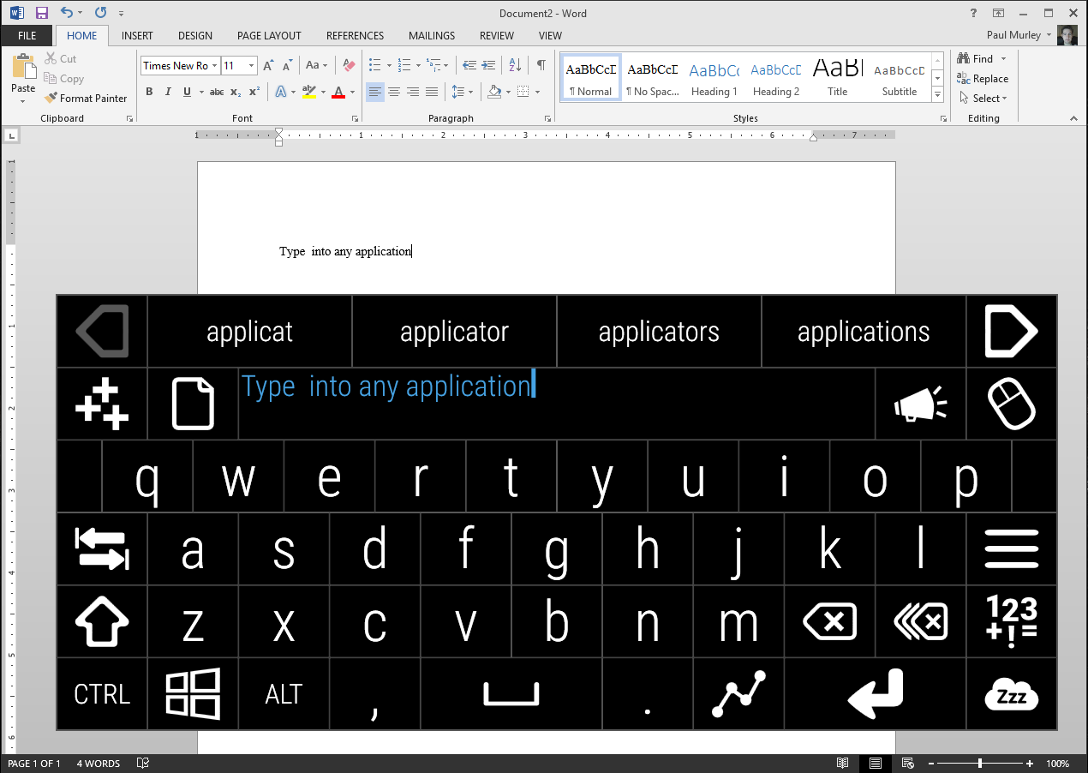
OptiKey-Keyboard

Slide 7
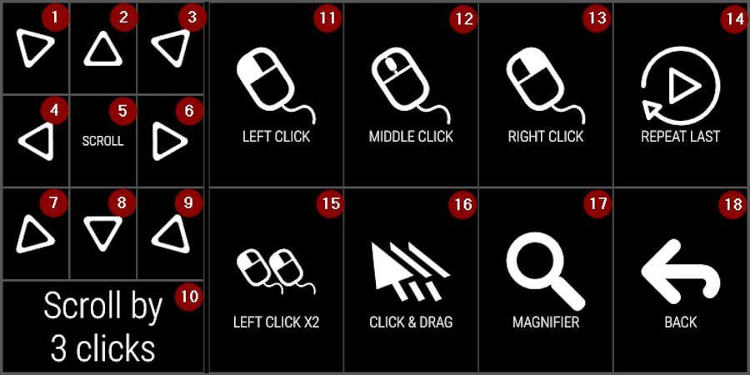
Optikey-Mouse controls

Slide 8
Requirements
Change the Keyboard color
Output sound should be male and female voice

Slide 9
Conclusions
OptiKey can Completely replace the pysical keyboard and mouse,and it is also possible to read the input sentences by machine sound.

Slide 10
Thank you for listening

